Slide 1
Project Road Map
Introduction
Data Load (imbalanced Data)
Explorative Data Analysis
Data Preprocessing / Data imputation
Model Building
Logistic Regression
Random Forest
Ada Boost
XG Boost
Model Evaluation
Evaluation Metric
Classification Report
AUC-ROC Curve
Summary -Report
Diabetic Predictor App
Feature Importance

Slide 2

Data Visualization
Milestone 1
Data Preprocessing – Measure of Central Tendency
Correlation Matrix
Model Evaluation – Confusion Matrix
Model Evaluation – Classification Report
Model Evaluation – AUC-ROC curve
Milestone 2
Diabetic Predictor App

Slide 3
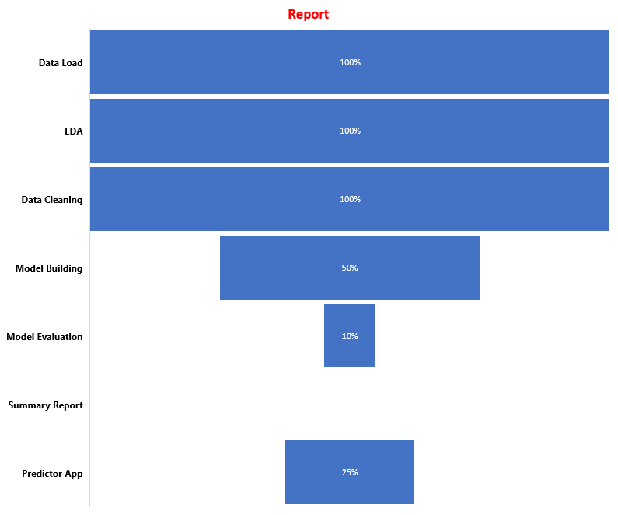
CURRENT STATUS

Slide 4
Roles & Responsibilities
Phase | Role
EDA | Team
Data Preprocessing | Deepa
Model Building- Logistic Regression | Indira
Random Forest | Deepa
Ada Boost | Darshan
XG Boost | Saloj

Slide 5

Questions
Let’s explain them our project and confirm whether we need to test Hypothesis- Our objective of this project is to build a predictive app and find the feature which is highly corelated for diabetics.

